Slide 1
Digestion in Mouth
1

Slide 2
Processes involved in nutrition are 1.Ingestion 2.Digestion 3.Absorption 4.Assimilation 5.Egestion
5/26/2020
TOPIC/COURSE CODE-NAME/FACULTY/DEPT/COLLEGE
2/10

Slide 3
The canal is divided into different parts:
The Mouth or Buccal Cavity Food Pipe or Oesophagus Stomach Small Intestine Large Intestine Anus
5/26/2020
TOPIC/COURSE CODE-NAME/FACULTY/DEPT/COLLEGE

Slide 4
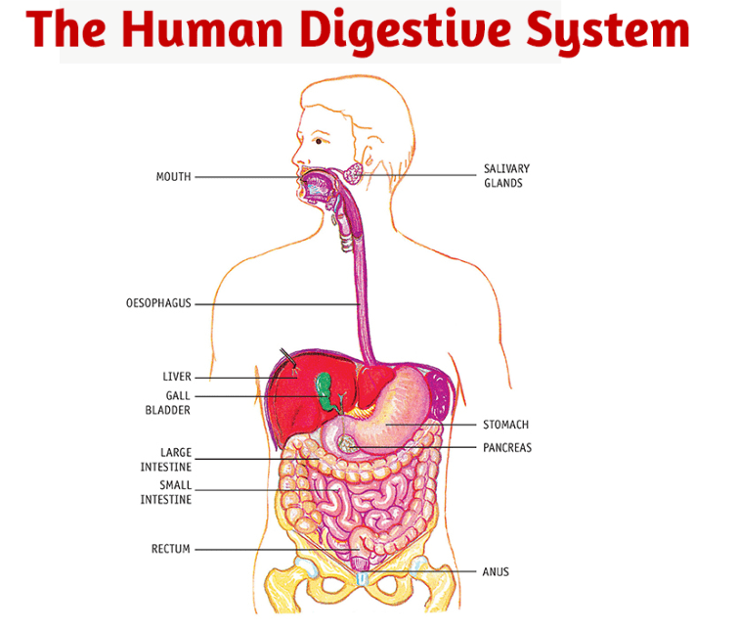
5/26/2020
TOPIC/COURSE CODE-NAME/FACULTY/DEPT/COLLEGE

Slide 5
There are three glands associated with the alimentary canal that secrete digestive juices that are used to convert the complex food substances into simpler substances. liver pancreas salivary glands
5/26/2020
TOPIC/COURSE CODE-NAME/FACULTY/DEPT/COLLEGE
6/10

Slide 6
The Mouth or Buccal Cavity
Ingestion - the process of taking in the food through the mouth is called ingestion.
The food is chewed with the help of teeth, saliva and the tongue present in the mouth.
The salivary glands present in our mouth secrete saliva which mixes with the food, moist it and breaks the starch present in the food into sugar.
The tongue present in the mouth helps in mixing the food with the saliva and helps in swallowing it inside the mouth. It also has taste buds which help in identifying the taste of anything that we eat. Besides this, the tongue also helps in talking.

Slide 7
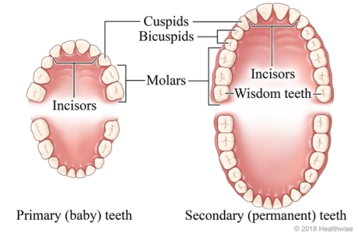
Milk Teeth VS Permanent Teeth
Milk Teeth - In the early childhood a set of teeth growth in children that then fall off after certain age 6 to 8 years. These teeth are called Milk Teeth.
Permanent Teeth - The teeth that grow after milk teeth fall off are called Permanent Teeth. They generally remain during the lifetime of a person or at least until old age.

Slide 8
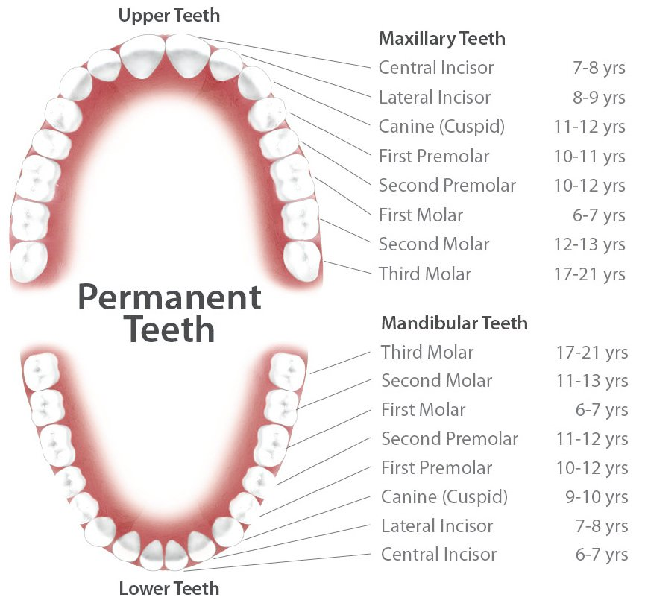
Teeth of an Adult

Slide 10
The Tongue
muscular organ
that helps you to eat food
pushes food towards your teeth
helps to mix the food with saliva
enables you to swallow it.
taste bud can detect all tastes—sweet, salty, sour and bitter.

